Slide 1

Department of Cyber Security
2026-2027- Odd Semester
III Year /V Sem
CS23533-FOUNDATIONS OF ARTIFICIAL INTELLIGENCE
Zeroth Review – 05-08-2026

Slide 2
AI-BASED EMERGENCY RESOURCE ALLOCATION SYSTEM
Batch Members : 2
1. DHARSHINI.S 241901026
2. KEERTHIKA.K 241901046
Supervisor:
Dr. S.Bhuvana
^{Assistant Professor[SG]}

Slide 3
OUTLINE
Abstract
Objective
Literature Survey
Summary of Literature
Proposed System & Novelty
Block Diagram
Hardware/Software requirements
References

Slide 4
ABSTRACT
Emergency situations such as road accidents, fires, and medical emergencies require quick and efficient allocation of available emergency resources. The AI-Based Emergency Resource Allocation System is designed to support intelligent decision-making by automatically assigning the most suitable emergency resource based on the type, priority, and location of the emergency. The system functions as an intelligent agent that analyzes emergency requests and allocates available resources such as ambulances, fire trucks, and police vehicles using knowledge-based rules. To minimize response time, the A* search algorithm is used to determine the shortest and most efficient route from the selected resource to the emergency location. The system also considers resource availability and road conditions while making allocation decisions. By providing fast, consistent, and logical resource allocation, the proposed system improves emergency response efficiency compared to manual methods. This project demonstrates the practical application of classical Artificial Intelligence concepts, including Intelligent Agents, Heuristic Search, and Knowledge-Based Reasoning, without using Machine Learning, Deep Learning, or Neural Networks.

Slide 5
OBJECTIVE
To develop an AI-based emergency resource allocation system that intelligently assigns the most appropriate emergency resource based on the type, priority, and location of an emergency.
To implement a knowledge-based decision-making mechanism using predefined rules for selecting suitable emergency resources such as ambulances, fire trucks, and police vehicles.
To utilize the A* search algorithm for identifying the shortest and most efficient route from the selected emergency resource to the incident location, thereby reducing response time.
To consider resource availability and road conditions during the allocation process to ensure efficient and practical emergency response.
To improve the speed, accuracy, and consistency of emergency resource allocation compared to conventional manual allocation methods.
To demonstrate the application of classical Artificial Intelligence techniques, including Intelligent Agents, Heuristic Search, and Knowledge-Based Reasoning, without relying on Machine Learning, Deep Learning, or Neural Networks.

Slide 6
Literature Survey
TITLE | YEAR | AUTHOR | TECHNIQUE
Finding Shortest Path of the Ambulance Routing Using an A* Algorithm Interface | 2012 | Nordin et al. | A* Search Algorithm
A Review of Incident Prediction, Resource Allocation, and Dispatch Models for Emergency Management | 2022 | Ayan Mukhopadhyay et al. | Resource Allocation and Computer-Aided Dispatch
Designing Decision Support Systems for Emergency Response | 2022 | Geoffrey Pettet et al | Decision Support System

Slide 7
EXISTING SYSTEM
Manual, operator-driven dispatch causes delays during high call volumes.
No systematic prioritization of emergencies by severity level.
Resource allocation depends on operator judgement, leading to inconsistent decisions.
No automated shortest-route computation; drivers rely on personal road knowledge.
Limited real-time visibility of resource availability, so busy resources are sometimes assigned.
Road status/closures are not factored into routing decisions.
No explanation or audit trail is provided for a dispatch decision.

Slide 8
PROPOSED SYSTEM
System Architecture
  Rational intelligent agent perceives emergency type, location and priority level.
  Knowledge-based rules select the most suitable resource (ambulance / fire truck / police vehicle).
  A* search algorithm computes the shortest feasible route on a predefined city-map graph.
  Resource availability and road status are checked to avoid invalid assignments.
  Output: allocation decision + optimal route + explanation for the decision.
  Prototype implemented using Python and Flask.
Algorithms
  Intelligent Agent
  A* Search Algorithm (Heuristic Search)
  Knowledge-Based Rules for resource selection

Slide 9
Novelty in Proposed System
Uses Classical AI instead of Machine Learning, making the system simple, explainable, and reliable.
Knowledge-Based Reasoning intelligently selects the most suitable emergency resource based on emergency type, priority, and location.
Intelligent Resource Allocation considers both resource availability and emergency priority before assignment.
A* Search Algorithm identifies the shortest and fastest route, reducing response time.
Automated Decision-Making minimizes human intervention and reduces manual errors.
Improves emergency response efficiency through logical, consistent, and optimized resource allocation.

Slide 10
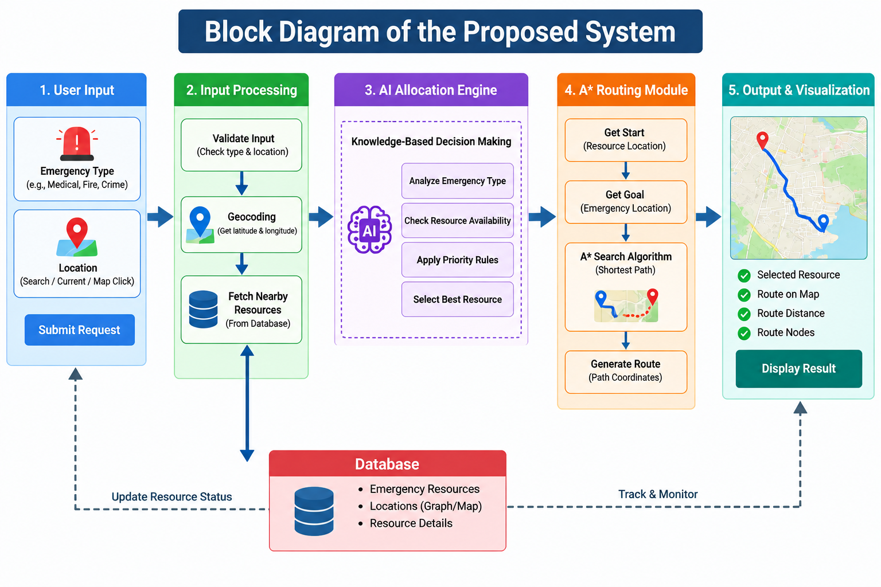
BLOCK DIAGRAM(PROPOSED SYSTEM)

Slide 11
Hardware/Software Requirements
Hardware Requirement:
Intel Core i3 or above
4 GB RAM
10 GB free storage
Laptop/Desktop
Internet & GPS/Location access
Software Requirement:
Windows 10/11
Python 3.x
Flask
NetworkX
OSMnx
Leaflet.js
OpenStreetMap
HTML, CSS, JavaScript
VS Code
Chrome/Edge/Firefox

Slide 12
References
N. A. M. Nordin, Z. A. Zaharudin, M. A. Maasar, and N. A. Nordin, "Finding Shortest Path of the Ambulance Routing: Interface of A Algorithm Using C# Programming,"* in Proceedings of the 2012 IEEE Symposium on Humanities, Science and Engineering Research (SHUSER), Kuala Lumpur, Malaysia, June 24–27, 2012, pp. 1569–1573, https://ieeexplore.ieee.org/document/6268841
A. Mukhopadhyay, G. Pettet, S. M. Vazirizade, D. Lu, A. Jaimes, S. E. Said, H. Baroud, Y. Vorobeychik, M. J. Kochenderfer, and A. Dubey, "A Review of Incident Prediction, Resource Allocation, and Dispatch Models for Emergency Management," in Accident Analysis & Prevention, vol. 165, Art. no. 106501, 2022,https://doi.org/10.1016/j.aap.2021.106501
G. Pettet, A. Mukhopadhyay, M. J. Kochenderfer, and A. Dubey, "Hierarchical Planning for Resource Allocation in Emergency Response Systems," in Proceedings of the 12th ACM/IEEE International Conference on Cyber-Physical Systems (ICCPS 2021), Nashville, TN, USA, May 2021, https://doi.org/10.1145/3450267.3450543

